Slide 1

Enhancing Loan Approval Process : Leveraging ML to identify Creditworthy Applicants
Team 9
Aditya Rawat (35404094)
Cheyujie Chen (34413731)
Shweta Pagare (35415169)
Taha Rizvi
(35461411)

Slide 2

Introduction
This project aims to enhance the loan approval process through data-driven insights, striking a crucial balance between fairness to borrowers and effective risk management for lending institutions. By analyzing comprehensive datasets, such as loan application data from Kaggle, we intend to refine approval mechanisms to ensure equitable treatment of applicants while safeguarding lenders against defaults. Employing advanced analytics and machine learning models, like Random Forest and Logistic Regression, the project will identify key predictors of loan repayment behavior. This approach not only promises a more transparent and fair loan approval process but also aims to boost the financial stability of lenders by enabling smarter, data-informed lending decisions.
Explanation of the Problem Statement
Team 9

Slide 3

Problem Analysis
Lets take a look at how can we address the problem statement and discuss the possible solutions.
Team 9

Slide 4
Challenges
In the dynamic landscape of financial services, the process of loan approval stands as a pivotal point where the delicate balance between risk management and borrower satisfaction is negotiated.
Traditional methods of assessment often struggle to navigate the complexities of evaluating creditworthiness, leaving lending institutions vulnerable to risks of default and borrowers potentially underserved.
However, with the advent of Machine Learning (ML) and data analytics, there emerges an unprecedented opportunity to revolutionize this process.
By harnessing the power of data-driven insights, lending institutions can now delve deeper into the intricate web of factors influencing loan repayment behaviours, thus enabling more informed and equitable decision-making.
This project aims to explore and compare how ML algorithms can be effectively leveraged to optimize the loan approval process, identifying creditworthy applicants while concurrently mitigating the risks associated with defaulters, ultimately reshaping the financial landscape for the better
Justification of the problem statement and possible future works.
Team 9

Slide 5
Process Cycle for Deploying ML model for the problem set
Data Understanding
Handling missing values
Encode
categorical
variables
Splitting the data
Model Selection
Feature Selection
Model Evaluation
Deploy the model
Team 9

Slide 6
Process Cycle for Deploying ML model for the problem set
Data Understanding
Understand the structure of your dataset, including the features (variables) available and their types.
Identify the target variable, which in this case would be a binary variable indicating whether a client defaulted on their loan or not.
Team 9

Slide 7
Process Cycle for Deploying ML model for the problem set
Data Understanding
Handling missing values
Encode
categorical
variables
Splitting the data
Model Selection
Feature Selection
Model Evaluation
Deploy the model
Team 9

Slide 8
Process Cycle for Deploying ML model for the problem set
Handling missing values
Impute or remove missing data depending on the extent of missingness and its impact on the analysis.
Decide whether to remove outliers or transform them based on domain knowledge and the impact on the models.
Team 9

Slide 9
Process Cycle for Deploying ML model for the problem set
Data Understanding
Handling missing values
Encode categorical variables
Splitting the data
Model Selection
Feature Selection
Model Evaluation
Deploy the model
Team 9

Slide 10
Process Cycle for Deploying ML model for the problem set
Encode categorical variables
Converting categorical variables into numerical format using techniques like one-hot encoding or label encoding.
Team 9

Slide 11
Process Cycle for Deploying ML model for the problem set
Data Understanding
Handling missing values
Encode categorical variables
Splitting the data
Model Selection
Feature Selection
Model Evaluation
Deploy the model
Team 9

Slide 12
Process Cycle for Deploying ML model for the problem set
Feature Selection
Identify the features that are likely to be strong indicators of loan default based on domain knowledge and exploratory data analysis.
Team 9

Slide 13
Process Cycle for Deploying ML model for the problem set
Data Understanding
Handling missing values
Encode categorical variables
Splitting the data
Model Selection
Feature Selection
Model Evaluation
Deploy the model
Team 9

Slide 14
Process Cycle for Deploying ML model for the problem set
Model Selection
Select classification algorithms suitable for binary classification tasks such as Logistic Regression, Decision Trees, Random Forests, Gradient Boosting Machines, or Support Vector Machines.
Team 9

Slide 15
Process Cycle for Deploying ML model for the problem set
Data Understanding
Handling missing values
Encode categorical variables
Splitting the data
Model Selection
Feature Selection
Model Evaluation
Deploy the model
Team 9

Slide 16
Process Cycle for Deploying ML model for the problem set
Splitting the data
Dividing the dataset into training and testing sets to train the models on one set and evaluate their performance on another.
Team 9

Slide 17
Process Cycle for Deploying ML model for the problem set
Data Understanding
Handling missing values
Encode categorical variables
Splitting the data
Model Selection
Feature Selection
Model Evaluation
Deploy the model
Team 9

Slide 18
Process Cycle for Deploying ML model for the problem set
Model Evaluation
Evaluating the performance of each model using appropriate evaluation metrics such as accuracy, precision, recall, F1-score, and ROC-AUC.
Team 9

Slide 19
Process Cycle for Deploying ML model for the problem set
Data Understanding
Handling missing values
Encode categorical variables
Splitting the data
Model Selection
Feature Selection
Model Evaluation
Deploy the model
Team 9

Slide 20
Process Cycle for Deploying ML model for the problem set
Deploy the model
Once the satisfactory model is selected, deploy it into production where it can be used to assess loan applications.
Continuously monitor the performance of the deployed model and retrain it periodically with new data to ensure its effectiveness over time.
Team 9

Slide 21
Process Cycle for Deploying ML model for the problem set
Data Understanding
Handling missing values
Encode categorical variables
Splitting the data
Model Selection
Feature Selection
Model Evaluation
Deploy the model
Team 9

Slide 22
Exploratory Data Analysis
Lets take look at our problem data sets and explore the options available.
Team 9

Slide 23
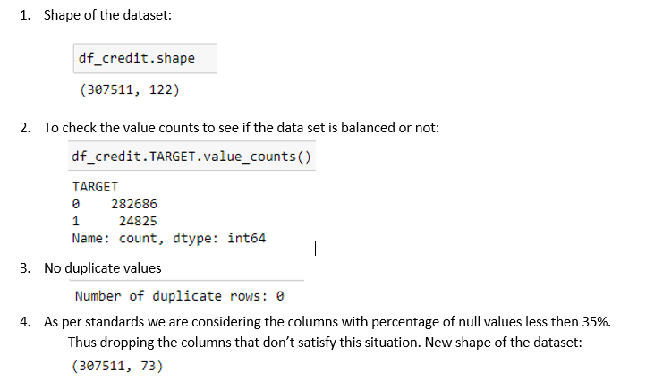
Exploratory Data Analysis
After uploading the dataset in Jupyter Notebook, we went through the steps below to explore our problem set:
Team 9

Slide 24
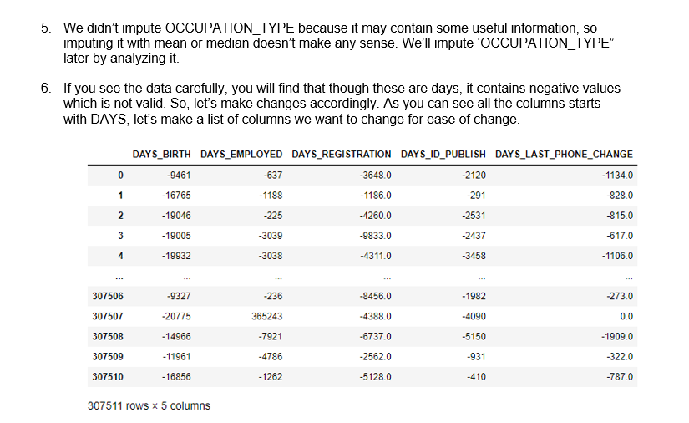
Exploratory Data Analysis
After uploading the dataset in Jupyter Notebook, we went through the steps below to explore our problem set:
Team 9

Slide 25
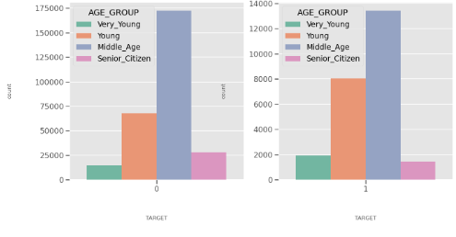
Interesting Insights
While analysing the data, we came to the following conclusions
It seems like Female clients applied higher than male clients for loan
The middle aged group(35-60) seems to have applied for loans more than any other group, and they are the ones with major difficulties in paying the loan off, when compared to the young and retired applicants.
Team 9

Slide 26
Interesting Insights
Some important features which contributed to the target variable
NAME_CONTRACT_TYPE :
Most of the clients have applied for Cash Loan while very small proportion have applied for Revolving loan for both Defaulters as well as Non-defaulters.
NAME_EDUCATION_TYPE:
Clients having education Secondary or Secondary Special are more likey to apply for the loan.
Clients having education Secondary or Secondary Special have higher risk to default. Other education types have minimal risk.
NAME_FAMILY_STATUS :
In case of Defaulters, Clients having single relationship are less risky
In case of Defaulters, Widows shows Minimal risk.
Team 9

Slide 27
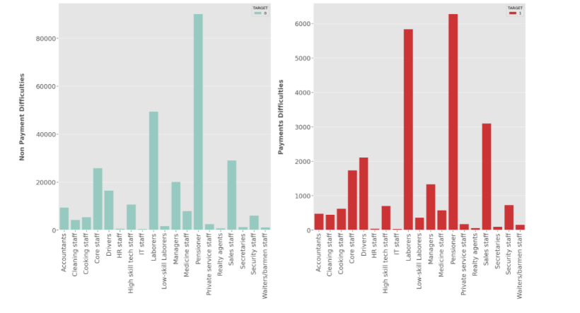
Interesting Insights
OCCUPATION_TYPE:
Pensioners have applied the most for the loan in case of Defaulters and Non-Defaulters.
Pensioner being highest followed by laborers have high risk to default.
Team 9

Slide 28
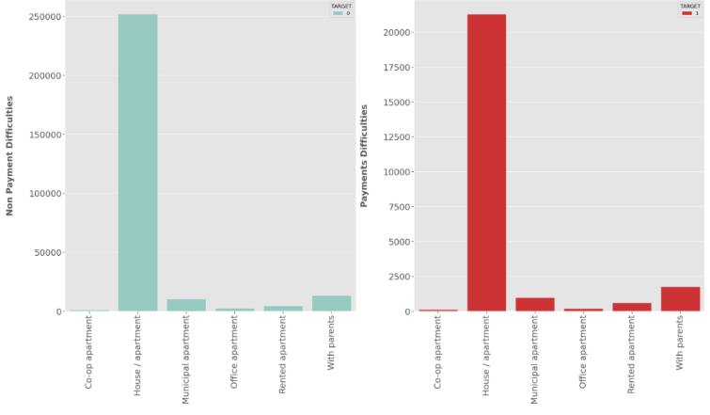
Interesting Insights
NAME_HOUSING_TYPE:
From the bar chart, it is clear that Most of the clients own a house or living in an apartment for both Defaulters and Non-Defaulters.
Team 9

Slide 29
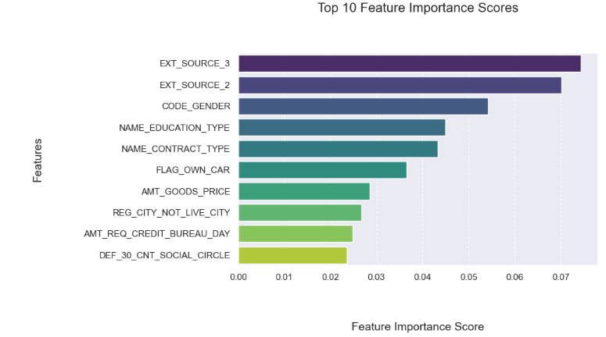
Feature importance based on XG Boost
We have calculated feature score using XG Boost
Team 9

Slide 30

Random Forest
Machine Learning Algorithm
The Random Forest is one of the supervised learning algorithms for both classification and regression. It is an ensemble approach that consists of many decision trees.
Why Random Forest:
Easy to implement, Prevent overfitting
Random Forest got good performance in credit fraud detection.
Team 9

Slide 31
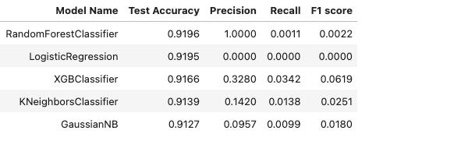
Applied ML models for the problem set
Team 9

Slide 32
Why Random Forest
Upon researching some research papers with similar problem sets we found out:
Random Forest can deal with imbalanced data, and its performance can be improved by changing base classifiers (Xuan et al., 2018).
Random Forests can handle both numerical and categorical data. They do not require the transformation of variables or creation of dummy variables.
The algorithm inherently supports parallel processing since each tree is built independently. This feature significantly speeds up the training process, especially on systems with multi-core processors (Breiman, 2001).
Team 9
Team 9

Slide 33

What’s Next
Hyperparameter Tuning: We will fine-tune the hyperparameters to check if the performance of our models can be improved.
Feature reduction: For now we have been using all the parameters available for our models, but we are planning to use the feature score obtained from the xgboost model to decide on which features to include and which to remove.
We will also try to apply Deep Learning Methods to see if we can obtain better results.
Team 9
Team 9

Slide 34
References
Xuan, S. et al. (2018) ‘Random Forest for credit card fraud detection’, 2018 IEEE 15th International Conference on Networking, Sensing and Control (ICNSC) [Preprint]. doi:10.1109/icnsc.2018.8361343.
Breiman, L. (2001). ‘Random Forests. Machine Learning’, 45(1), 5-32.
Team 9

Slide 35


